Slide 1
Software Configuration Management
Notes:
<number>

Slide 2
Agenda
Objective
What is SCM
Introduction to Github
Basic Concept
Basic operations using Tortoise Git
Optimus Standard Configuration
Check-in and Check-out guidelines
Repository structure
Do’s and Don’ts for configuration management
Notes:
<number>

Slide 3
Objective
Do you work in a team?
Has it ever happened that you were working on a file, and someone else was working on the same file at the same time?
Did you lose your changes to that file because of that?
Have you ever saved a file, and then wanted to revert the changes you made?
Have you ever wished you could see what a file looked like some time ago?
Have you ever found a bug in your project and wanted to know when that bug got into your files?
Notes:
<number>

Slide 4
What is Software Configuration Management
Software Configuration Management is the ability to control and manage change in a software project.
Change Management defines processes to prevent unauthorized changes, procedures to follow when making changes, required information, possibly workflow management as well. Change management is orders of magnitude more complex than version control of software.
All SCM systems provide the following essential features:
Concurrency Management - Concurrency refers to the simultaneous editing of a file by more than one person
Versioning - Versioning refers to keeping track of file revisions which makes it possible to re-create (or roll back to) a previous version of the file
Synchronization – Updating local copy, Modifying and Checking- in modified files is called synchronization
Notes:
<number>

Slide 5
Introduction to Github
As a standard practice across the organization, Optimus decided to use Github as a configuration management tool for various projects.
Server – Gitserver is hosted on Amazon and can be accessed from anywhere.
Client – TortoiseGit is a Git revision control client, implemented as a Microsoft Windows shell extension. It is free software released under the GNU General Public License.
Download Link:
http://code.google.com/p/tortoisegit/wiki/Download
Tortoise Git Tutorial:
http://uncod.in/blog/github-tortoisegit-and-organizational-workflow-tutorial/
Notes:
<number>

Slide 6
Basic Concept
Git is a decentralized version control system. The "decentralized" bit sets it apart from other version control systems like CVS, SVN or Perforce. "Decentralized" means that there is no central repository -- each developer has a repository (or a few copies) that contains the entire history of everything. This has some advantages:
You can make commits without being network-connected
You can commit without worrying about build-breakage
In a disaster scenario, you're fine unless every copy of the repo is wiped out
Notes:
<number>

Slide 7
Basic Operations
Diff
Commit
Add
Delete
Pull
Push
Revert
Repo Browse
Show log
Compare
Create Branch
Create Tag

Slide 8
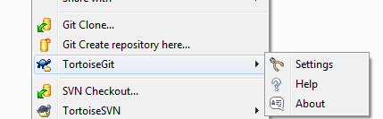
The TortoiseGit menu for undersigned folders
Save your user credentials under ‘Settings’!
Notes:
<number>

Slide 9
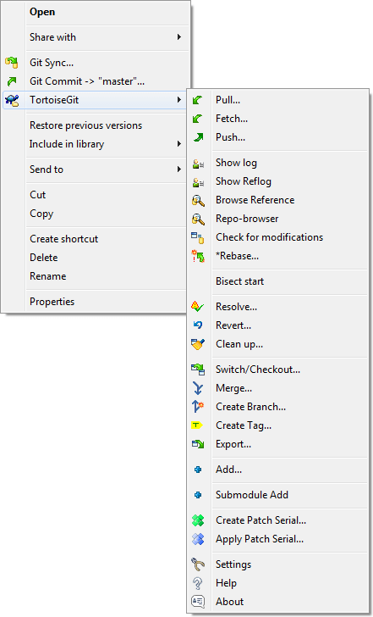
Context menu for a directory under version control
Notes:
<number>

Slide 10
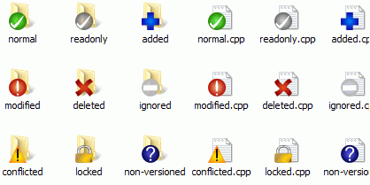
Explorer showing icon overlays

Slide 11
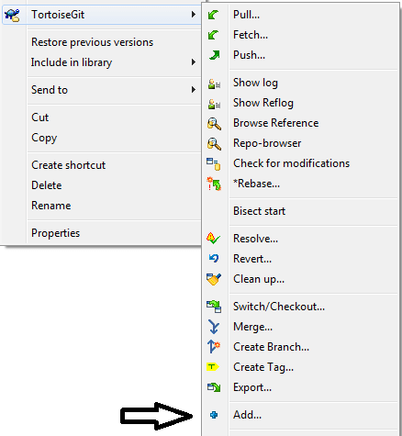
Making Changes, adding commits

Slide 12
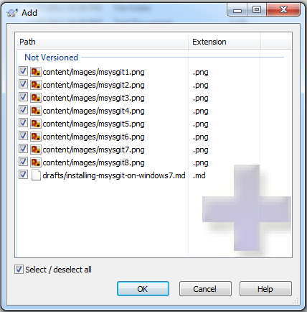
Adding files

Slide 13
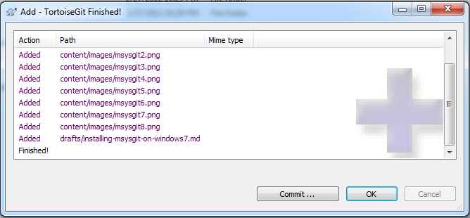

Slide 14
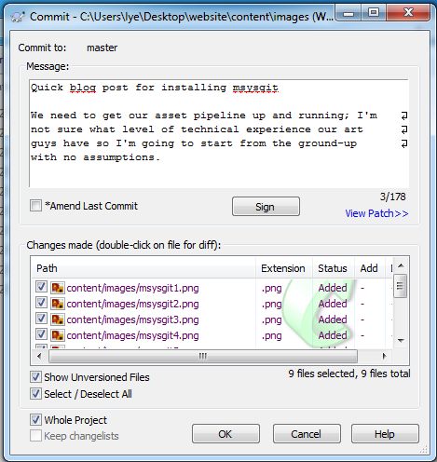
Commit

Slide 15
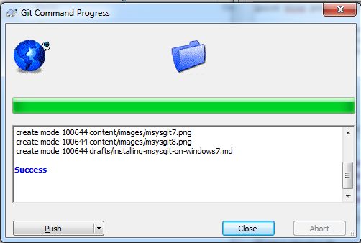

Slide 16
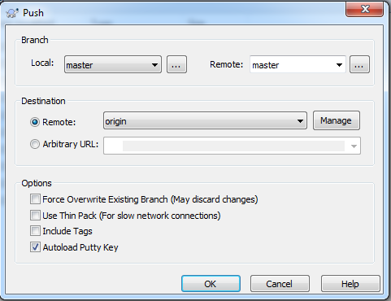
Push to Master

Slide 17
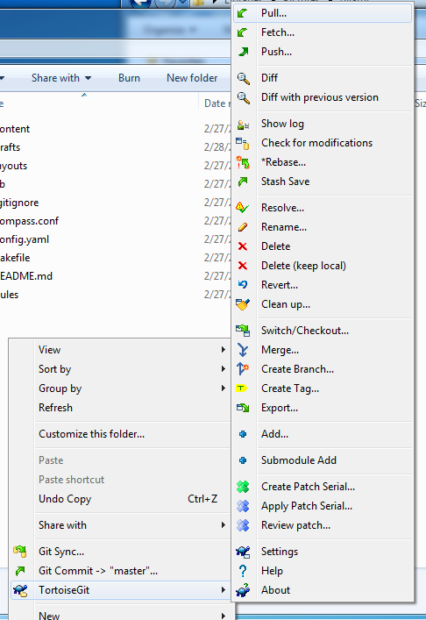
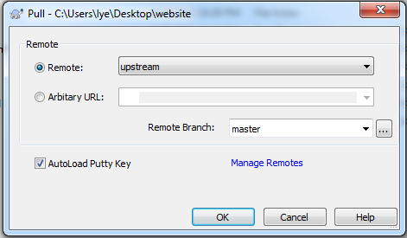
Pull Request

Slide 18
Optimus Standard Configuration
A typical Optimus deployment will be structured as below –
Repository will be used mainly for configuration management of source code
The number of branches in repository – typically there will be
One main trunk
Each version delivered to Client for demo or testing will be tagged using following convention Del#_<ddMMMyy>
Each version delivered to the QA team will be tagged as below IntQA#_<ddMMMyy>
When a delivery is accepted as a final delivery of the project, it will be given a tag as shown below Signoff#_App(or Module)Name_<ddMMMyy>
Continue…

Slide 19
Optimus Standard Configuration
As and when there is need to do application maintenance and bug fix work post acceptance
A branch will be created on the tag denoting the last sign off to Client, thus Signoff#_BugFix_<ddMMMyy> (The # will be same as the value of the last signoff number in 1.a.iv)
Each version delivered to Client for demo or testing will be tagged using following convention Del#_<ddMMMyy>
Each version delivered to the QA team will be tagged as below IntQA#_<ddMMMyy>
Upon final acceptance, the version of the code will be merged back into the main trunk, with a tag using the below conventions Signoff#_App(or Module)Name_<ddMMMyy> (The # will be one more than the value of the last signoff number in 1.a.iv)
Suggestion: Client may decide to incorporate version and build information in the application’s user interface for possible cross checking Continue…

Slide 20
Optimus Standard Configuration
Except for third party libraries, binary files will not be part of the source code configuration management
SQL Files for database scripts will be part of the software configuration management.
Configuration Management of documents and other such development artifacts will not be thorough SVN.
Check-in and Check-out guidelines –
Get the latest version of the code, before committing any changes in the repository.
In case of merge error, give priority to committed code and merge your changes over and
above it.
After merging of the code, use SVN cleanup command to clean up the repository.
In case of adding a new file, reference project should be committed.
Redmine ticket update should include the check‐in revision number.
In case of multiple check‐in for a single enhancement/feature, stable copies should be committed. Please check‐out the latest version and make sure that it builds properly.

Slide 21
Optimus Standard Configuration
Comments Guidelines
Every check‐in should have proper comments to be tracked later
In case of Defect
Defect: <Ticket Id>
Summary: <Change Short description>
In case of Enhancement/Feature
Enhancement : <Ticket Id>
Summary: <Change Short description>
In case of multiple check‐in for any Enhancement/Feature
Enhancement : <Ticket Id> In Progress
Summary: <Change Short description>
In case of Tag/Branch
Summary: <Short Description>

Slide 22
Optimus Standard Configuration
Repository Structure
Master
Source Code
Application Folder
Branches
Tags

Slide 23
Optimus Standard Configuration - Do’s and Don’ts for Configuration Management
Do’s
Write proper comment for the changes done. See comments guidelines for the same.
Always download the “Tag” and check that it build properly before sending to Client or testing team.
Don’ts
Don’t commit multiple check‐in for the single change.
Don’t commit any user specific files or binaries which will be dynamically generated. E.g. “User Options” file and “Bin/Obj” folders.
Don’t commit fixes for more than one defect in a single check‐in.

Slide 24
Thank You

